Slide 1
Polites: A Tool for the Automation of Processes Required to Deploy a Production OHDSI Instance on Top of Broadsea John Gresh, Curlew Consulting
Notes:
This presentation is an introduction to the Polites project. The Polites project automates the creation of a production, test, or development instance of a CDM and the connecting of that CDM instance to OHDSI tooling such as Atlas.

Slide 2
Outline
Broadsea
Polites
Notes:
Polites is built on top of Broadsea. Because of this, in this presentation we will look at Broadsea and what it does and does not do and then look at Polites and how Polites extends the automation achieved by Broadsea.

Slide 3
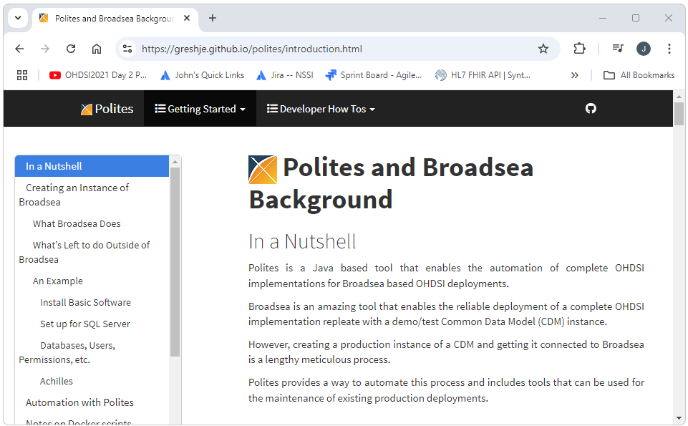
Follow Along At Home
The information in this presentation, as well as a wealth of other information about Polites is available here: https://greshje.github.io/polites/introduction.html
Notes:
Most of what we’ll talk about here, and a wealth of information about Polites, is available in our documentation, at the url shown here. We are in the process of migrating Polites to the http://github.com/OHDSI repository.

Slide 4
What is Broadsea
Broadsea is a Dockerized version of Atlas (and other applications)
A Dockerized application is an application packaged together with its dependencies inside a Docker container, ensuring it runs consistently across any environment
Broadsea is a ready to run preconfigured version of Atlas (and other applications)
Notes:
Broadsea is a fully automated turnkey solution to deploying the OHDSI stack of software replete with a demo/test CDM instance. Because Broadsea is Dockerized, there are no software dependencies other than Docker. All software dependencies are contained within the Docker container provided by Broadsea.

Slide 5
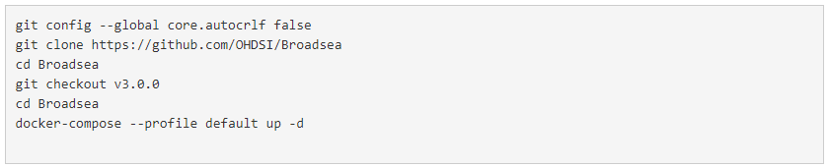
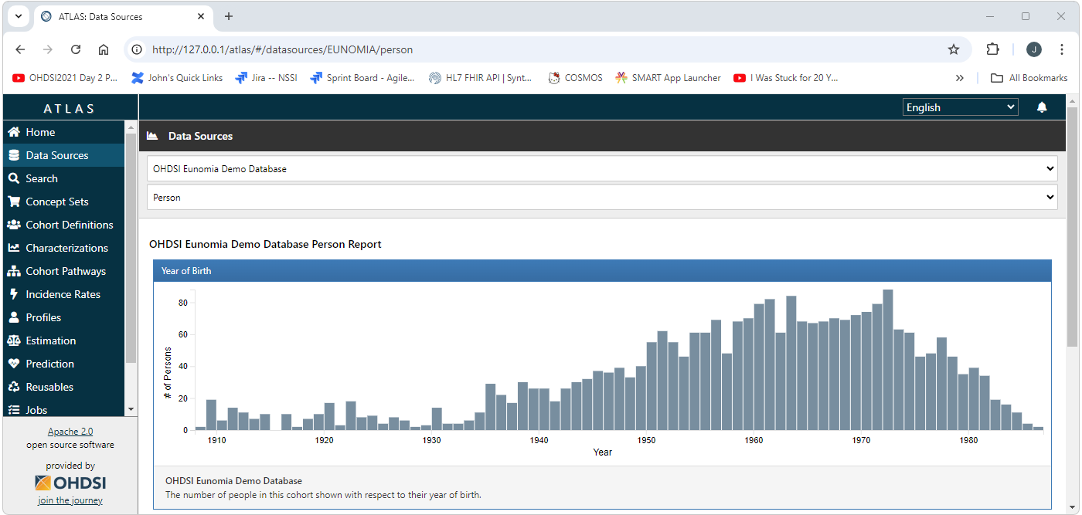
With Broadsea
Notes:
Broadsea can be instantiated and up and running in minutes using a few simple commands.

Slide 6
Without Broadsea
Installation of software dependencies such as Java, Tomcat, PostgreSql, etc.
Configure Postgres: https://github.com/OHDSI/webapi-wiki/blob/master/PostgreSQL-Installation-Guide.md
WebAPI installation: https://github.com/OHDSI/webapi-wiki/blob/master/WebAPI-Installation-Guide.md
CDM Configuration: https://github.com/OHDSI/webapi-wiki/blob/master/CDM-Configuration.md
Atlas Configuration and Deploy: https://github.com/OHDSI/Atlas/wiki/Atlas-Setup-Guide
Notes:
With out Broadsea, we need to go through a series of complicated steps to build our OHDSI Instance.

Slide 7
What is Broadsea? A turnkey implementation of OHDSI
Notes:
In other words, Broadsea has done all the work required to create an instance of OHDSI and put it in a black box so you can deploy it virtually instantly to your local Docker. instance.

Slide 8
From Broadsea to Production
Notes:
However, at somepoint virtually every OHDSI implementation will require use of a CDM other than the demo CDM provided by docker.
This will usually be a CDM instance external to Docker.
This will now require that we have installed all of the software and other dependencies of this CDM/OHDSI implementation as well as our implementation of the CDM and the connecting of that CDM to the OHDSI software stack.
The steps required to do this are detailed in the next few slides using Microsoft SQL Server as an example.

Slide 9
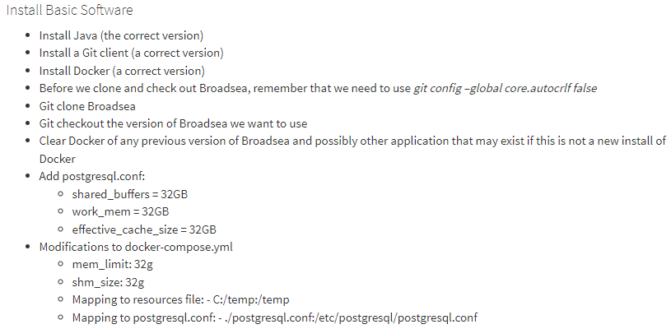
Install Basic Software
Notes:
These are the steps required to install the software our CDM and ODHSI software stack will need.

Slide 10
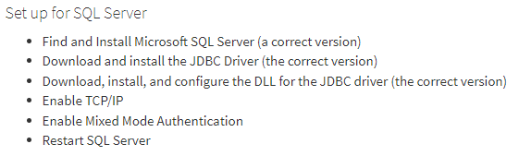
Installing and setting up SQL Server
Notes:
These are the steps required to set up the SQL Server instance.

Slide 11
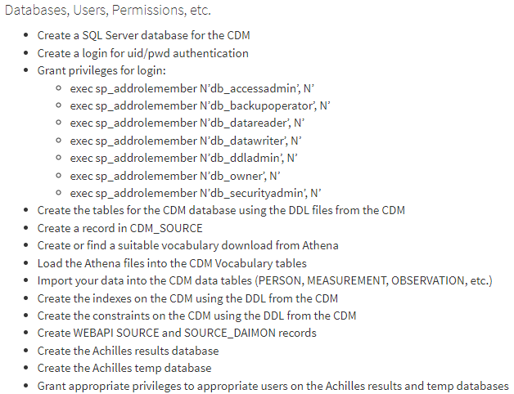
Create Database Users, Permissions, etc.
Notes:
These are the steps required to set up the CDM database.

Slide 12
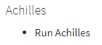
Run Achilles
Notes:
Running Achilles is required to get Atlas and other software up and running.

Slide 13
Automation with Polites
All of the above can be achieved using Polites in a few easy steps.
Not only is the Polites process much easier, it is also much more consistent, reliable, and repeatable than attempting to work through this process manually.

Slide 14
Automation with Polites
Install Basic Software Using Common Standard Versions
Download and run the YesPolitesInstaller-1.1.002.exe
Run the SQL Server and SSM installers provided by the YesPolitesInstaller found in c:\_YES_POLITES\databases\sqlserver
Run the Docker installer provided by the YesPolitesInstaller found in C:\_YES_POLITES\tools\docker and other tools as needed (e.g. R)
Install and configure Broadsea by running C:\_YES_POLITES\workspace\install-broadsea.bat
Start Docker by running C:\_YES_POLITES\workspace\Broadsea\start.bat
Install and Run Polites
Download and run the Latest Release of Polites
Restart Docker by running the stop.bat and start.bat files in C:\_YES_POLITES\workspace\Broadsea
Notes:
Polites has two main components:
1.) Downloading, installing, and configuring the software and other resources the CDM/OHDSI software stack depend on.
2.) Running the Polites software to create and manage our CDM/OHDSI instance.

Slide 15
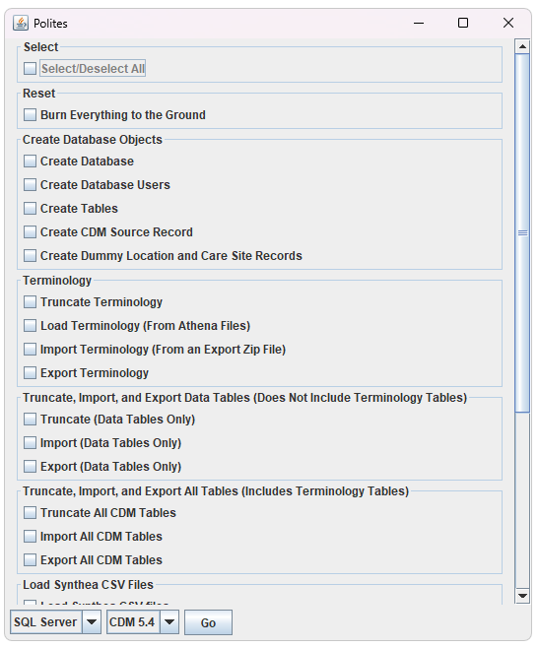
DEMO
Notes:
This is a screen shot showing some of the functionality of Polites.
For a demo, contact johngresh@curlewconsulting.com.

Slide 16
Summary
Broadsea fully automates the creation of an OHDSI software stack replete with a CDM instance
Moving from the demo/test CDM instance provided by Broadsea to your use case specific production, test, or development instance requires a lot of work
This work has been automated by Polites and involves two parts
Installation and configuration of dependent software and other resources
Running Polites to create and maintain your CDM/OHDSI instance
This process has been tested and works on a new install of Windows 11 with no other software or installs required
More information available at https://greshje.github.io/polites
Contact johngresh@curlewconsulting.com for more information
Next Steps
Rollout of Polites 1.0 and feedback from the community
Postgres Implementation
Databricks Implementation
CDM 5.3

